Slide 1
Logic Programming
Notes:
欢迎辞

Slide 2
Facts
father, mother, male and female are predicates
Example.
father(terach, abraham).
father(terach, nachor).
father(terach, haran).
father(abraham, issac).
father(haran, lot).
father(haran, milcah).
father(haran, yiscah).
mother(sarah, issac).
male(terach).
male(abraham).
male(nachor).
male(haran).
male(issac).
male(lot).
female(sarah).
female(milcah).
female(yiscah).

Slide 3
Facts
Example.
0 < 1.
0 < 2.
1 < 2.
0 < 3.
1 < 3.
2 < 3.

Slide 4
Queries
male(terach).
male(abraham).
male(nachor).
male(haran).
male(issac).
male(lot).
female(sarah).
female(milcah).
female(yiscah).
father(terach, abraham).
father(terach, nachor).
father(terach, haran).
father(abraham, issac).
father(haran, lot).
father(haran, milcah).
father(haran, yiscah).
mother(sarah, issac).
Query: father(abraham, issac)?
✔

Slide 5
Queries
male(terach).
male(abraham).
male(nachor).
male(haran).
male(issac).
male(lot).
female(sarah).
female(milcah).
female(yiscah).
father(terach, abraham).
father(terach, nachor).
father(terach, haran).
father(abraham, issac).
father(haran, lot).
father(haran, milcah).
father(haran, yiscah).
mother(sarah, issac).
Query: female(abraham)?
✘

Slide 6
Queries
male(terach).
male(abraham).
male(nachor).
male(haran).
male(issac).
male(lot).
female(sarah).
female(milcah).
female(yiscah).
father(terach, abraham).
father(terach, nachor).
father(terach, haran).
father(abraham, issac).
father(haran, lot).
father(haran, milcah).
father(haran, yiscah).
mother(sarah, issac).
Query: father(abraham, X)?
X=issac.
father(abraham, lot)?, father(abraham, milcah)?, ..., father(abraham, issac)?, ...
stops until an answer yes is given.

Slide 7
Universal Facts
likes(abraham, pomegranates).
likes(sarah, pomegranates).
......
likes(X, pomegranates).

Slide 8
Conjunctive Queries
male(terach).
male(abraham).
male(nachor).
male(haran).
male(issac).
male(lot).
female(sarah).
female(milcah).
female(yiscah).
father(terach, abraham).
father(terach, nachor).
father(terach, haran).
father(abraham, issac).
father(haran, lot).
father(haran, milcah).
father(haran, yiscah).
mother(sarah, issac).
Query: father(haran, X), male(X)?
X=lot.
Is there an X such that both ... ?

Slide 9
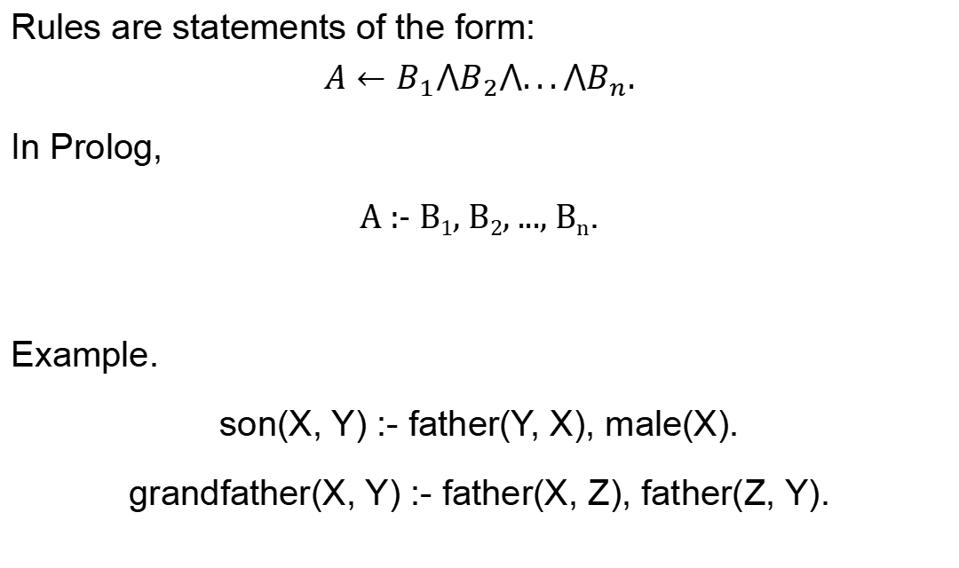
Rules
Rules are statements of the form:
$$A←B_{1}⋀B_{2}⋀...⋀B_{n}.$$
In Prolog,
A :- B₁, B₂, ..., B_{n}.
Example.
son(X, Y) :- father(Y, X), male(X).
grandfather(X, Y) :- father(X, Z), father(Z, Y).

Slide 10
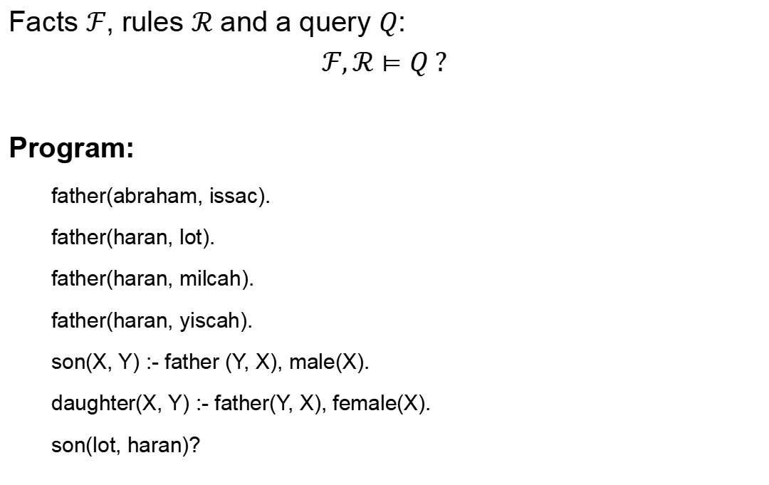
Logic Program
Facts $ℱ$, rules $ℛ$ and a query $Q$:
$$ℱ,ℛ⊨Q ?$$
Program:
father(abraham, issac).
father(haran, lot).
father(haran, milcah).
father(haran, yiscah).
son(X, Y) :- father (Y, X), male(X).
daughter(X, Y) :- father(Y, X), female(X).
son(lot, haran)?
Is $Q$ the logical consequence of $ℱ$ and $ℛ$ ?
male(issac).
male(lot).
female(milcah).
female(yiscah).

Slide 11
Recursive Programming
natural_number(X) : X is a natural number.
natural_number(0).
natural_number(s(X)) :- natural_number(X).

Slide 12
Example - Arithmetic
X ≤ Y : X and Y are natural numbers, s.t., X is less than or equal to Y.
0 ≤ X :- natural_number(X).
s(X) ≤ s(Y) :- X ≤ Y.
natural_number(0).
natural_number(s(X)) :- natural_number(X).

Slide 13
Example - Arithmetic
plus(X, Y, Z) : X, Y and Z are natural numbers, s.t., Z is the sum of X and Y.
plus(0, X, X) :- natural_number(X).
plus(s(X), Y, s(Z)) :- plus(X, Y, Z).
natural_number(0).
natural_number(s(X)) :- natural_number(X).

Slide 14
Example - List Concatenation
cat(X, Y, Z): X, Y and Z are lists, s.t., Z is the concatenation, i.e., Z = [X|Y].
cat([], Y, Y).
cat([V|X], Y, [V|Z]) :- cat(X, Y, Z).

Slide 15
Example - List Concatenation
cat(X, Y, Z): X, Y and Z are lists, s.t., Z is the concatenation, i.e., Z = [X|Y].
cat([], Y, Y).
cat([V|X], Y, [V|Z]) :- cat(X, Y, Z).
cat([1, 2], [3, 4], L)?
L=[1, 2, 3, 4].

Slide 16


Example - List Concatenation
cat(X, Y, Z): X, Y and Z are lists, s.t., Z is the concatenation, i.e., Z = [X|Y].
cat([], Y, Y).
cat([V|X], Y, [V|Z]) :- cat(X, Y, Z).
cat([1, 2], [3, 4], L)?
$ℱ$:
$ℛ$:
$Q$:
cat([], [3,4], [3,4])
cat([2], [3, 4], [2, 3, 4])
$ℱ,ℛ⊨Q$ ?
cat([1, 2], [3, 4], [1, 2, 3, 4])

Slide 17
Search
Idea: To solve a query Q,
If Q is a fact in the program, then done
Else, if Q :- Q₁,...,Q_{n} is a rule in the program, solve Q₁ ... Q_{n}.
Else, give up on this query.

Slide 18
"What" vs "How"
Declarative vs Procedural Programming
Procedural programming
The programmer has to specify how to get the output for the range of required inputs.
The programmer must know the appropriate algorithm.
Declarative programming
Requires a more descriptive style.
The programmer must know what relationships hold between various entities.

Slide 19
Example - List Concatenation
In procedural style:
list procedure cat(list a,list b)
{
list t = list u = copylist(a);
while (t.tail != nil) t = t.tail;
t.tail = b;
return u;
}
In declarative style:
cat([], Y, Y).
cat([V|X], Y, [V|Z]) :- cat(X, Y, Z).

Slide 20
Logic Programming
A declarative style programming paradigm.
Computation through logical deduction.
Uses the language of logic to express data and programs.
Most of current LP languages use first-order logic (FOL).
Prolog – the most popular logic programming language.

Slide 21
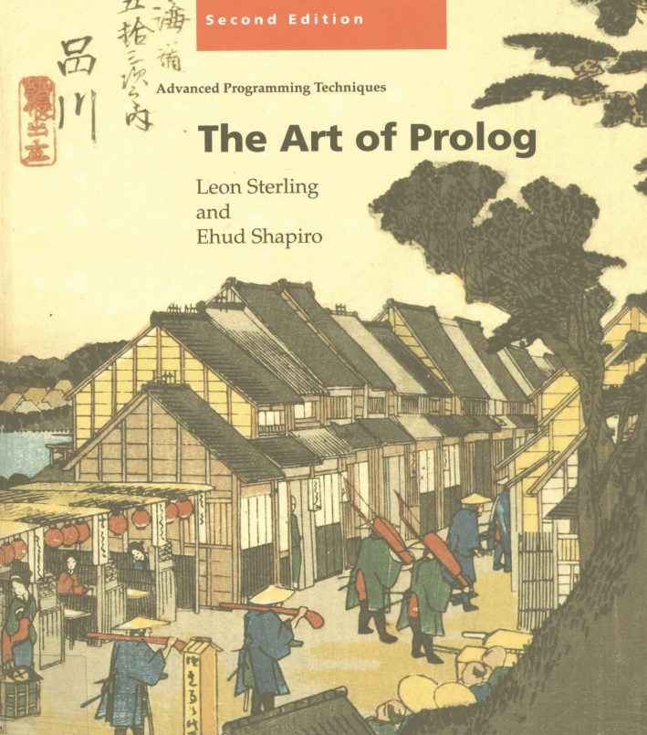

Logic Programming
A declarative style programming paradigm.
Computation through logical deduction.
Uses the language of logic to express data and programs.
Most of current LP languages use first order logic (FOL).
Prolog – the most popular LP language.
The Art of Prolog
The Craft of Prolog

